Slide 1

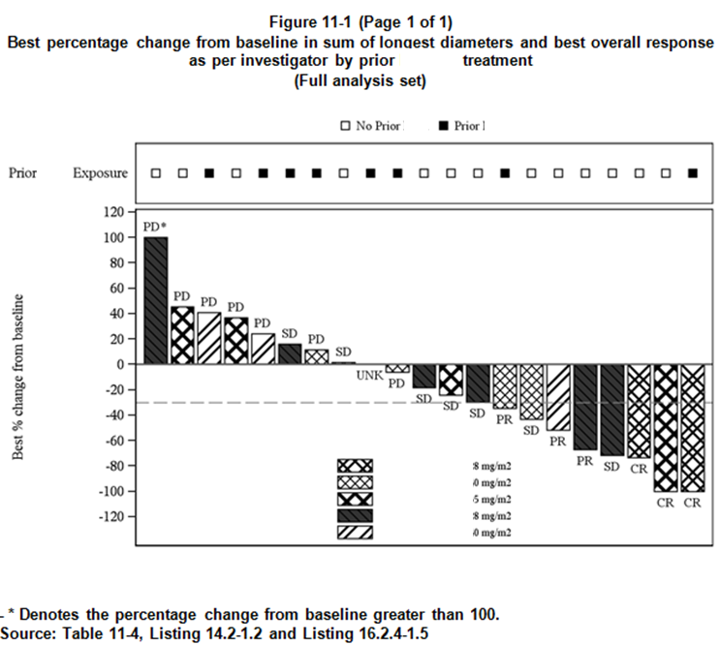
Lessons from a company wide data visualization initiative
Mark Baillie
Basel, 17th April 2024
https://graphicsprinciples.github.io/

Slide 2
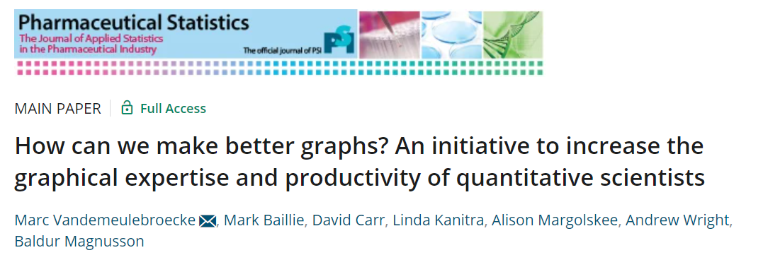
How can we make better graphs?
During 2014, Novartis formed a cross-functional Graphics Workstream to:
Enhance understanding and use of good graphical principles
Promote graphical thinking
Facilitate easy access to high quality graphics
Provide state-of-the-art ideas on graphical presentation of data for exploratory analyses
Outline a view of graphics at Novartis tomorrow
https://onlinelibrary.wiley.com/doi/full/10.1002/pst.1912

Slide 3

Vision: Tomorrow's ideal applied statistician
We understand when to construct information rich graphs vs concise message graphs
We are very familiar with principles of good graphics
We transition seamlessly from investigation to analysis to communication
We understand when to use graphics and when not
We are skilled with an advanced graphics package

Slide 4
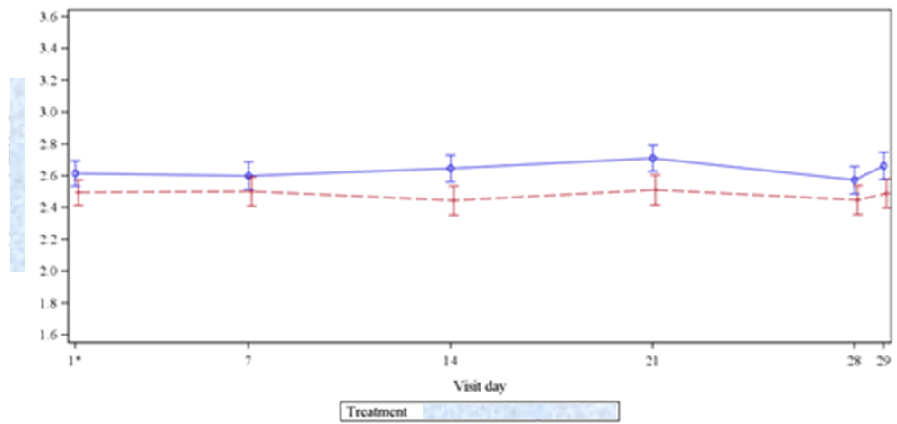
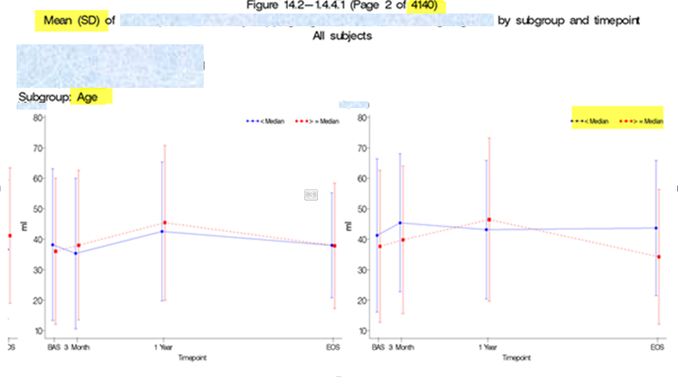
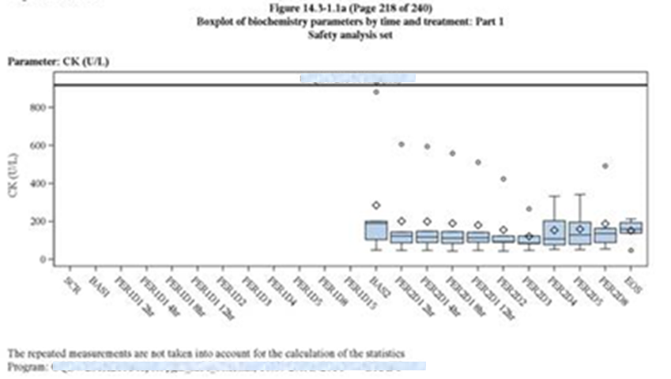
Goal: see less of these...

Slide 5
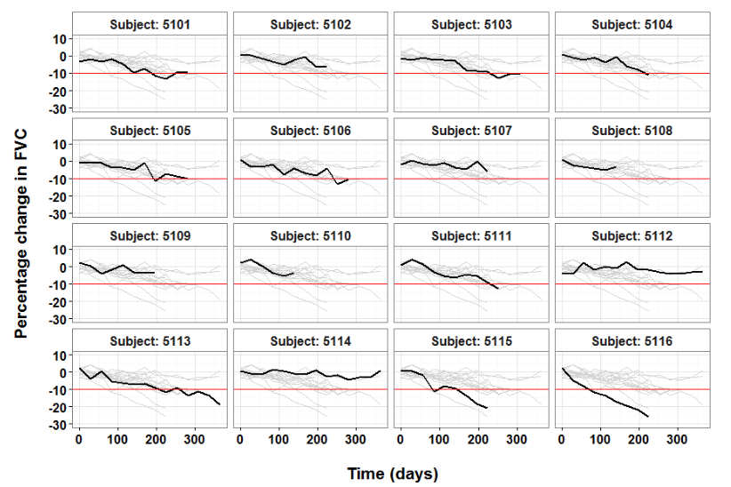
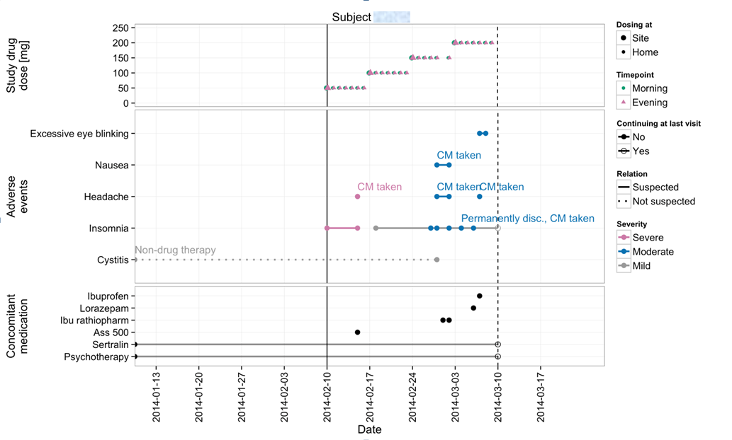
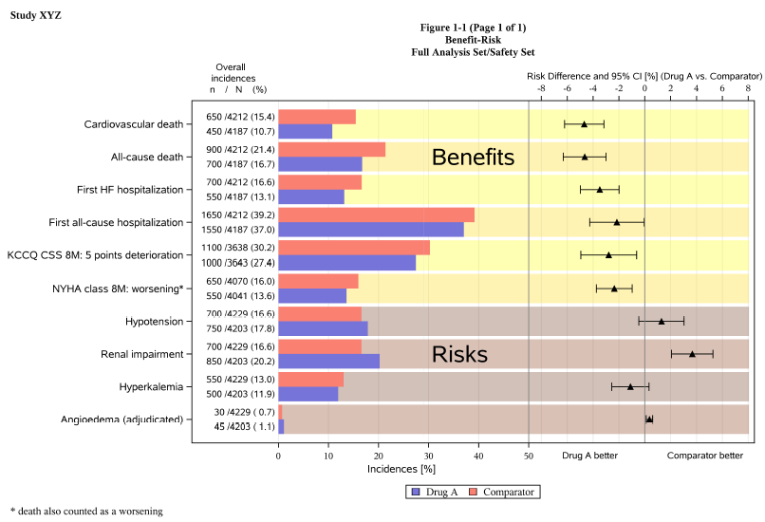
...and more of these

Slide 6
How do we get there?
How do we tell a good graph from a bad one?
How do we ensure we design a graph that is fit for purpose?
Recall workstream goal: enhance understanding and use of good graphical principles

Slide 7
Elements of the initiative
Graphical principles and thinking
Graphics Principles Cheat Sheet
Newsletter
Easing the implementation
Graph Gallery
Analysis Results Datasets
Standardization of most common/important graphs
Graphics tomorrow ... or today?
Question‐based visualizations and interactive graphics
...plus overarching stakeholder management and communication
https://onlinelibrary.wiley.com/doi/full/10.1002/pst.1912

Slide 8
Graphics Principles Cheat Sheet

Slide 9
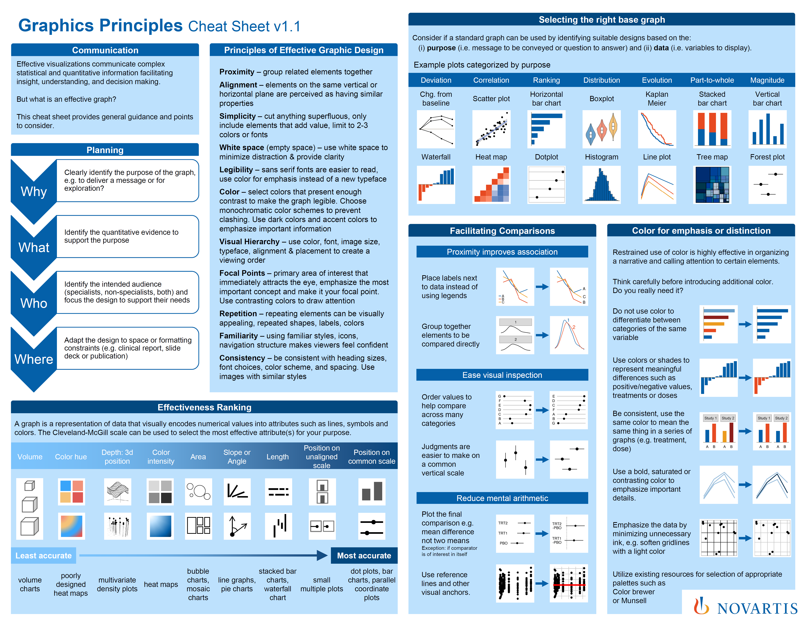
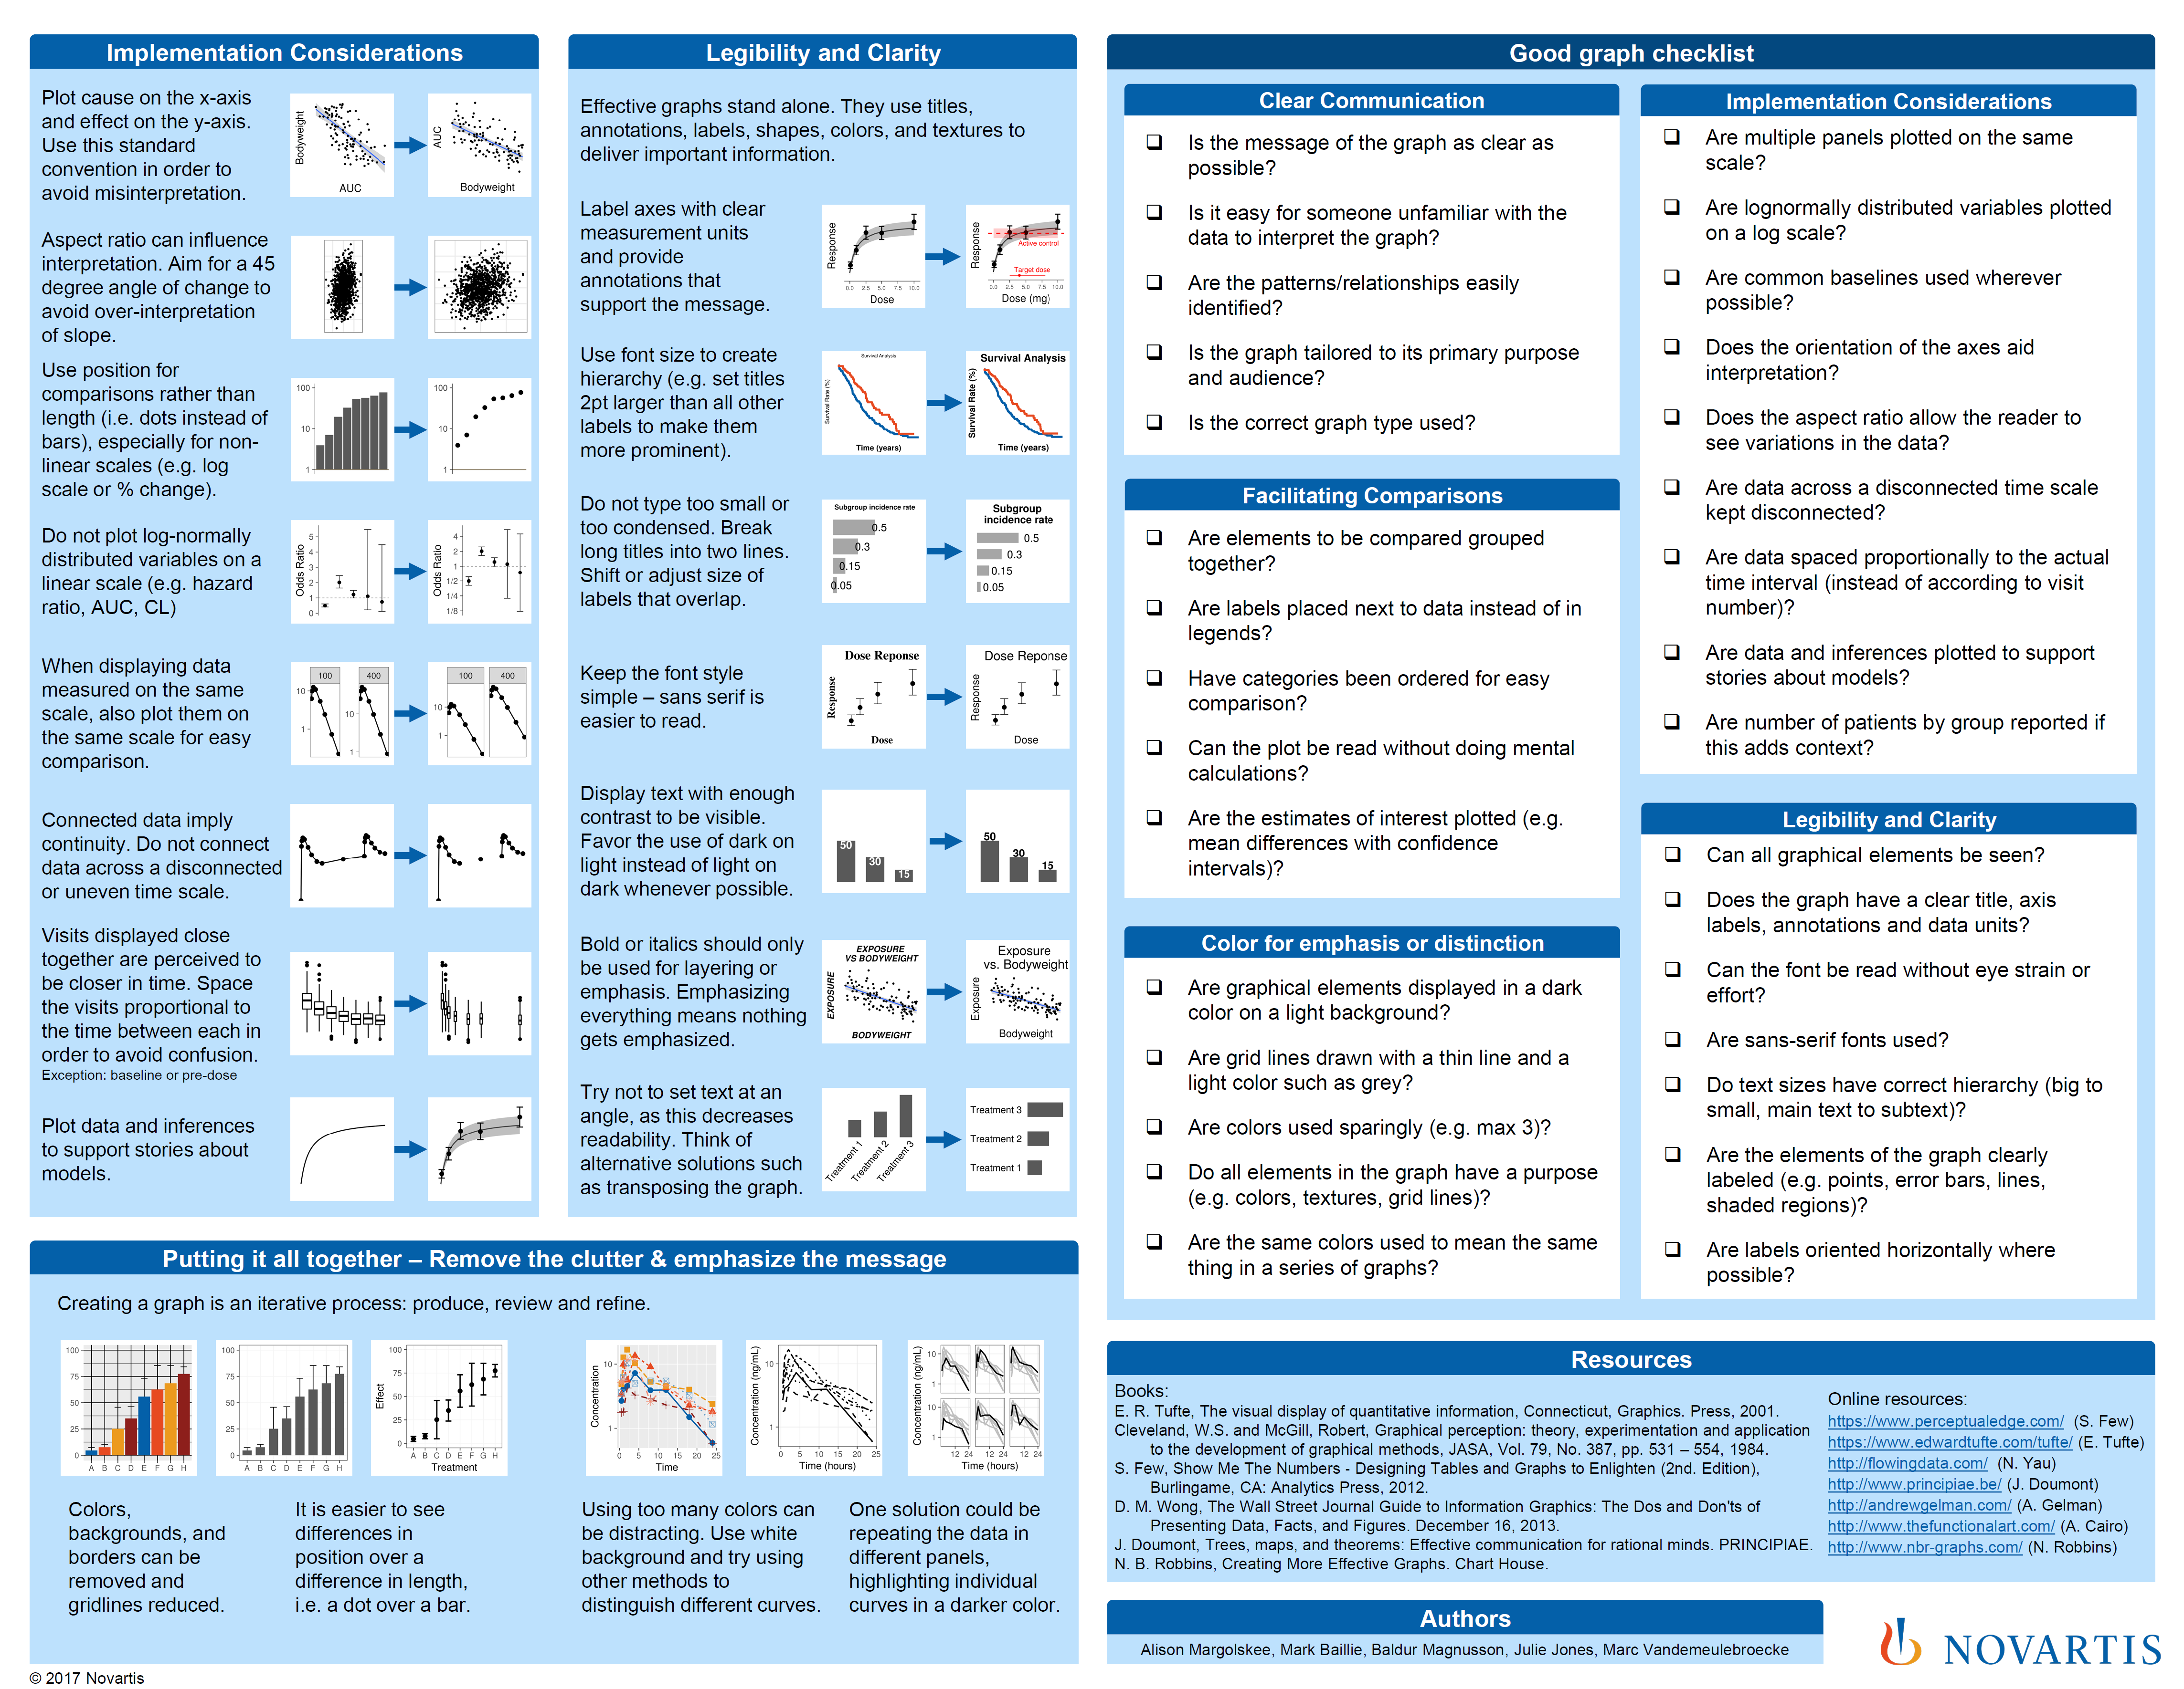
Graphics Principles Cheat Sheet
https://graphicsprinciples.github.io/cheatsheet.html

Slide 10

Planning questions
Why
Clearly identify the purpose of the graph, e.g. to deliver a message or for exploration?
What
Identify the quantitative evidence to support the purpose
Who
Identify the intended audience (specialists, non-specialists, both) and focus the design to support their needs
Where
Adapt the design to space or formatting constraints (e.g. clinical report, slide deck or publication)
Notes:
Why : exploration vs. explanation
What: quantitative evidence the more specific you are the more this will help defining the graph type. Is it about population or patient level data, is it continuous or categorical variable?

Slide 11
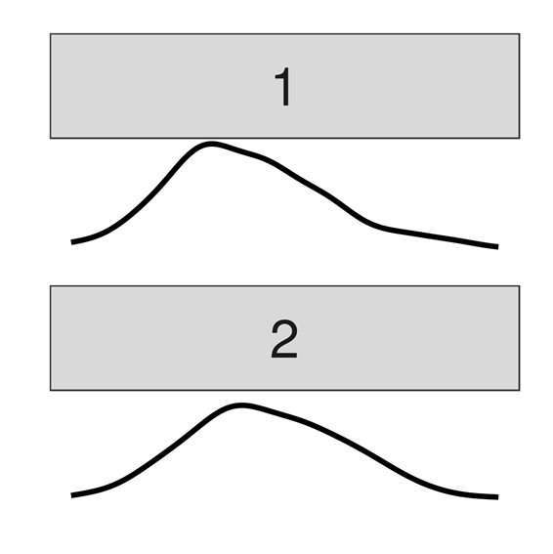
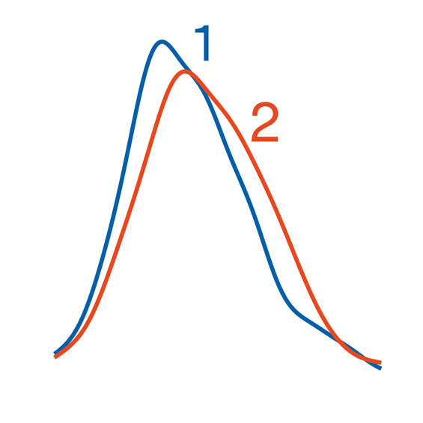
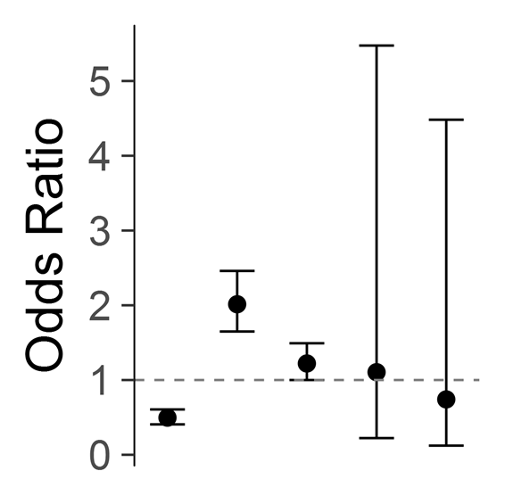
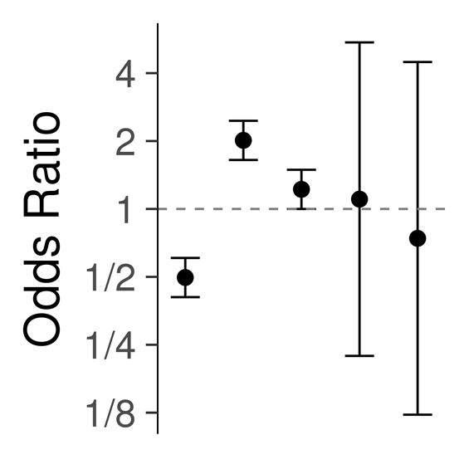


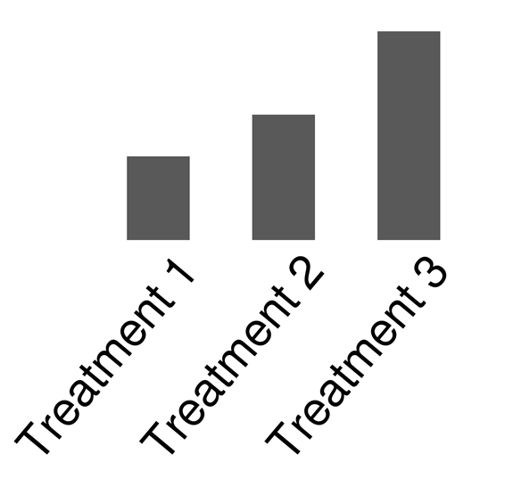
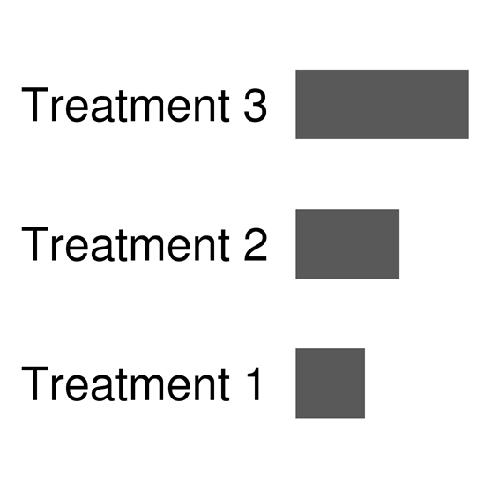
Tips & tricks
Notes:
Why : exploration vs. explanation
What: quantitative evidence the more specific you are the more this will help defining the graph type. Is it about population or patient level data, is it continuous or categorical variable?

Slide 12

Good graph checklist

Slide 13
Graphics Principles Cheat Sheet
https://graphicsprinciples.github.io/cheatsheet.html

Slide 14
Principles of effective visual communication

Slide 15
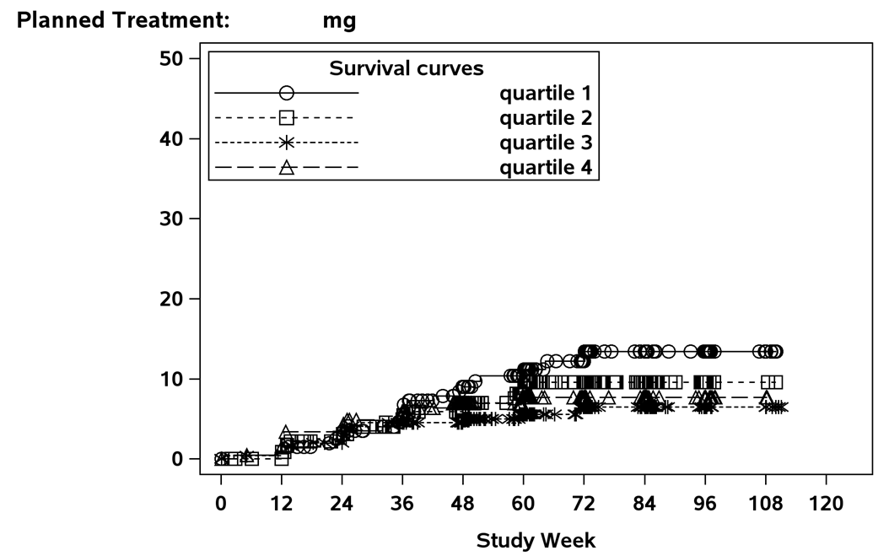
This is a continual process

Slide 16
How do we get there?
How do we tell a good graph from a bad one?
How do we ensure we design a graph that is fit for purpose?
Recall workstream goal: enhance understanding and use of good graphical principles

Slide 17
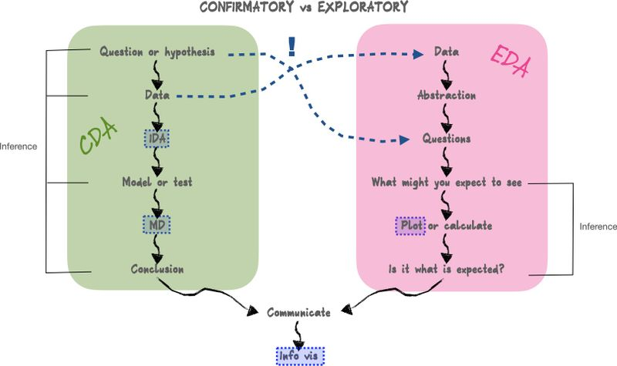
Where am I on the data analysis workflow
https://hdsr.mitpress.mit.edu/pub/mpdasaqt/release/2

Slide 18
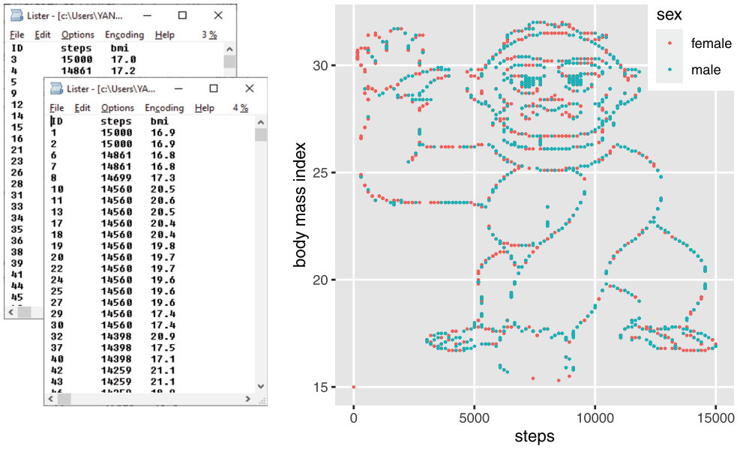
Plot your data to see patterns
https://genomebiology.biomedcentral.com/articles/10.1186/s13059-020-02133-w

Slide 19
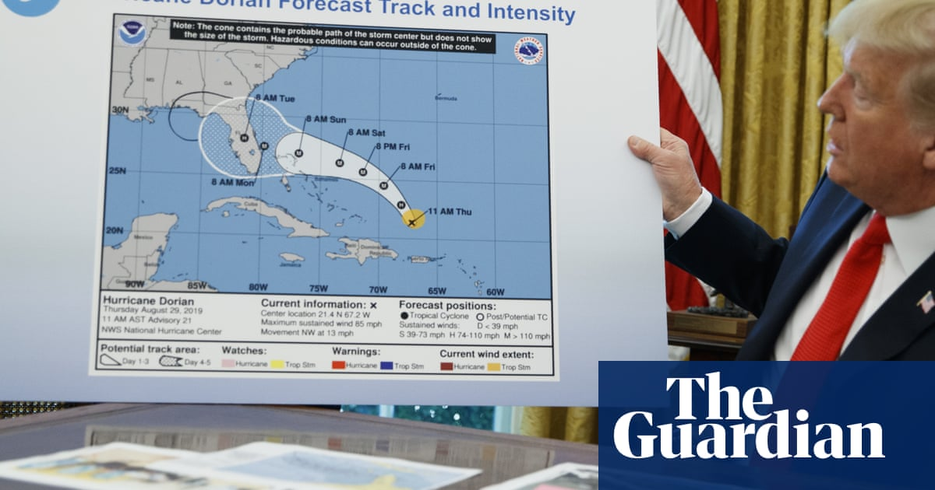
Don't mislead
https://www.theguardian.com/world/2019/sep/04/trump-hurricane-dorian-alabama-sharpie-map

Slide 20
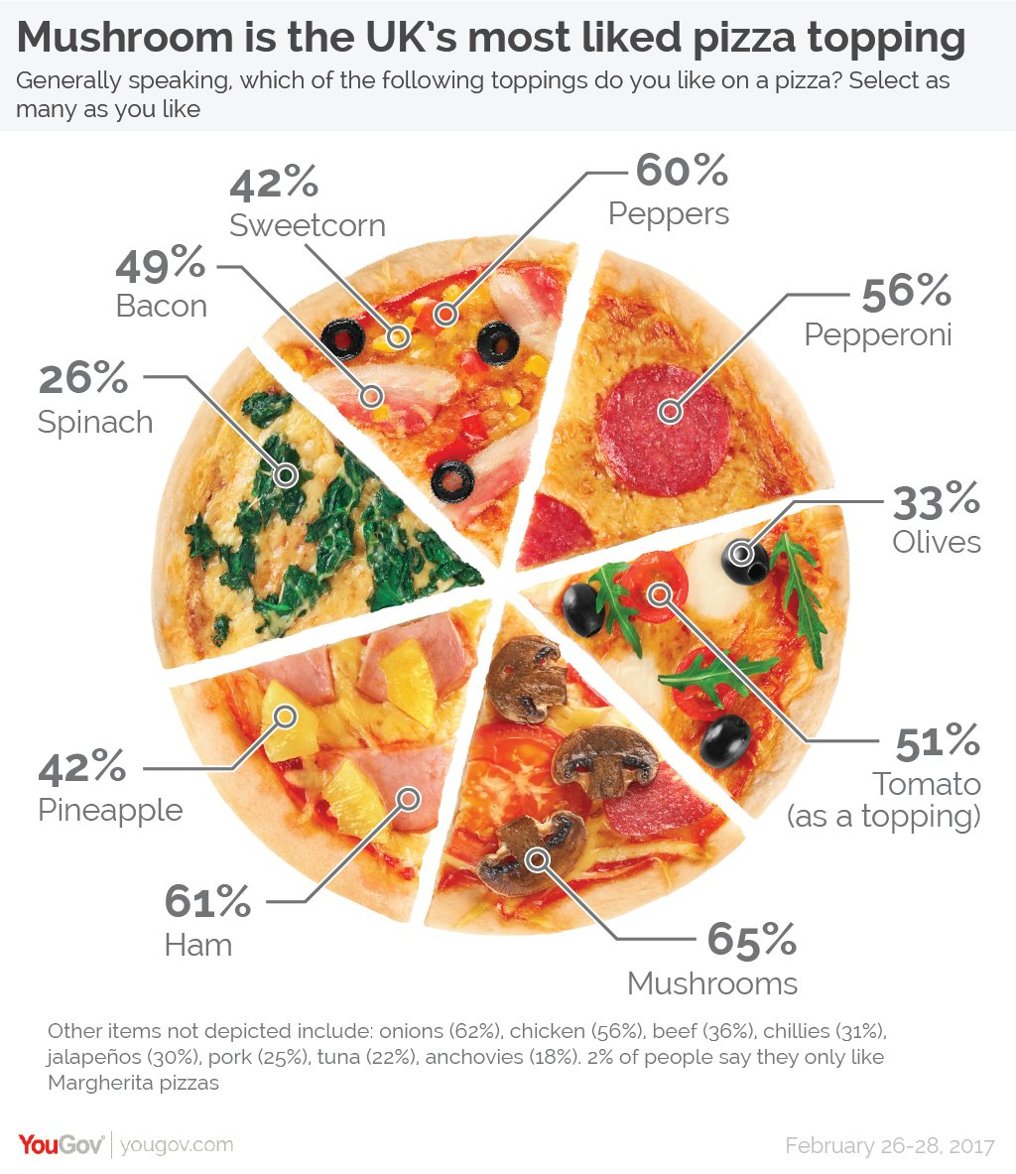
Don't confuse

Slide 21
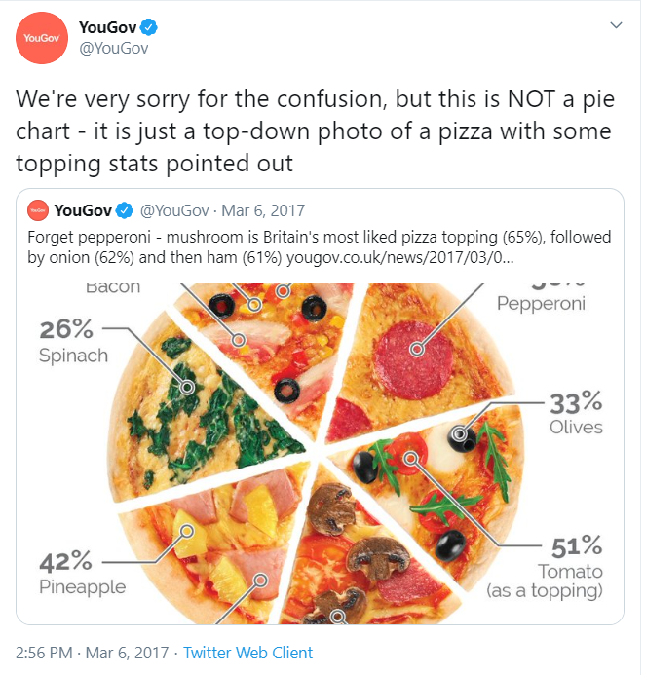
Don't worry
https://twitter.com/YouGov/status/838750115796041728

Slide 22
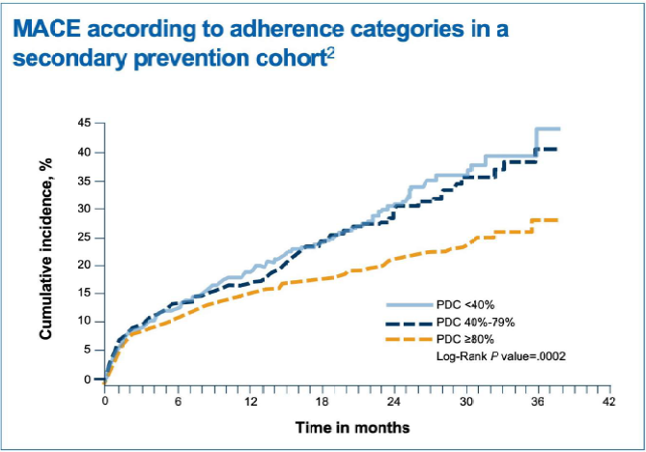
Act as a guide
Lower incidence of major adverse cardiac events associated with higher patient drug adherence
<40% proportion of days (low adherence)
40-79% adherence
>80% adherence

Slide 23
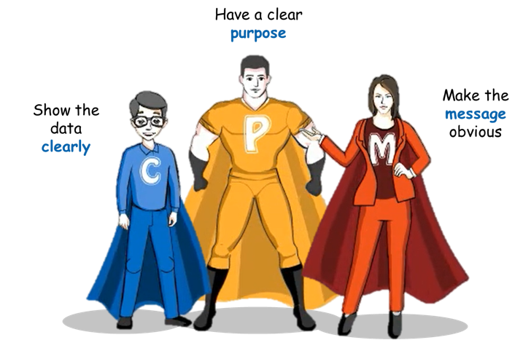

Effective Visual Communication (EVC)!
https://youtu.be/pfxulpF9XOw

Slide 24
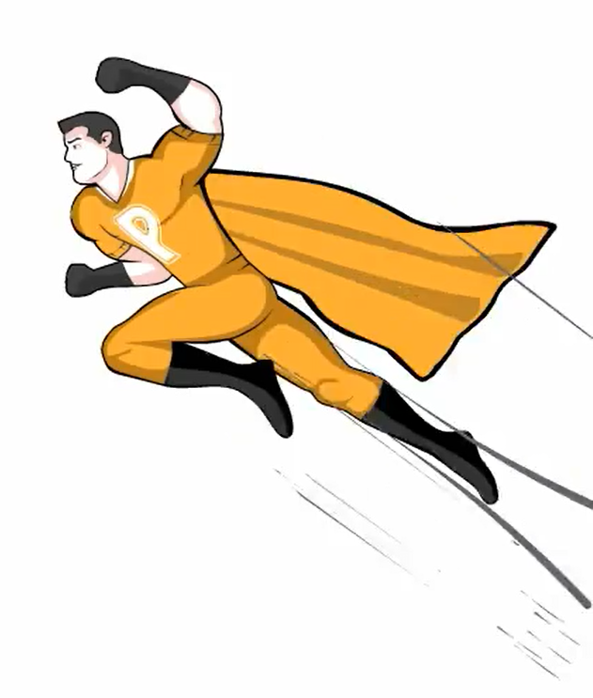


3 principles for better visual communication
Have a clear purpose
Understand the question you are trying to answer
Identify the quantitative evidence to answer that question
Know your audience and focus the design to support their needs
Show the data clearly
Choose the appropriate graph type to display your data
Avoid misrepresentation (use appropriate scales)
Maximize data to ink ratio (reduce distraction, less is more)
Make the message obvious
Minimize mental arithmetic (e.g. plot the difference)
Use proximity and alignment to aid in comparisons
Use colors and annotations to highlight important details
https://youtu.be/pfxulpF9XOw

Slide 25
Have a clear purpose
What is the question?
Who wants to know?
Why do they want to know?
What will they do with this knowledge?

Slide 26

Show the data clearly
Where’s Wally?

Slide 27

Show the data clearly
Where’s Wally?

Slide 28
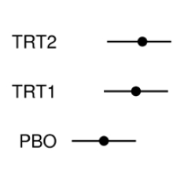
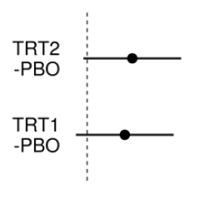
Make the message obvious
Show the answer!
Notes:
Letting your audience draw their own conclusions is risky.

Slide 29
4. Analysis results data sets

Slide 30
Analysis results data sets

Slide 31
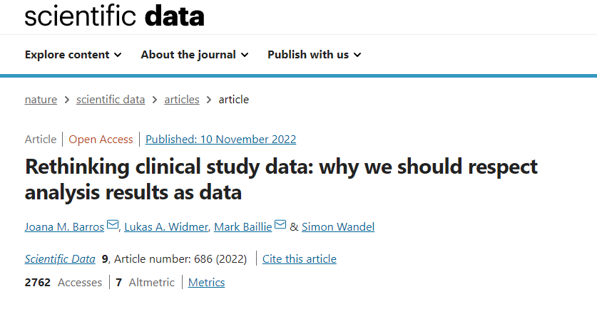
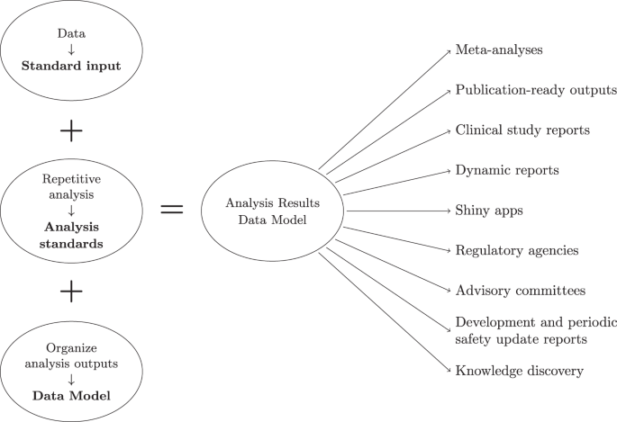
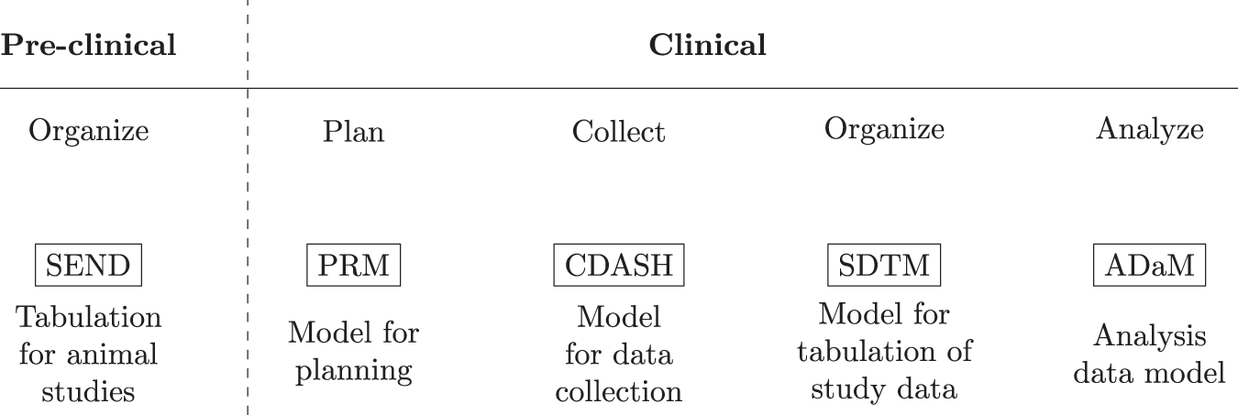
https://www.nature.com/articles/s41597-022-01789-2

Slide 32
Lessons from a company wide data visualization initiative

Slide 33
Why does it matter?
Data visualization and more importantly Effective Visual Communication (EVC) is essential in every step of a quantitative workflow, from scoping to execution through to communicating results and conclusions
Within the quantitative sciences, traditional university and professional training curricula have not focused on EVC
One hears regularly “I don’t understand this graph”
A visual representation can be very powerful if it is clear and aligned with the intended purpose

Slide 34
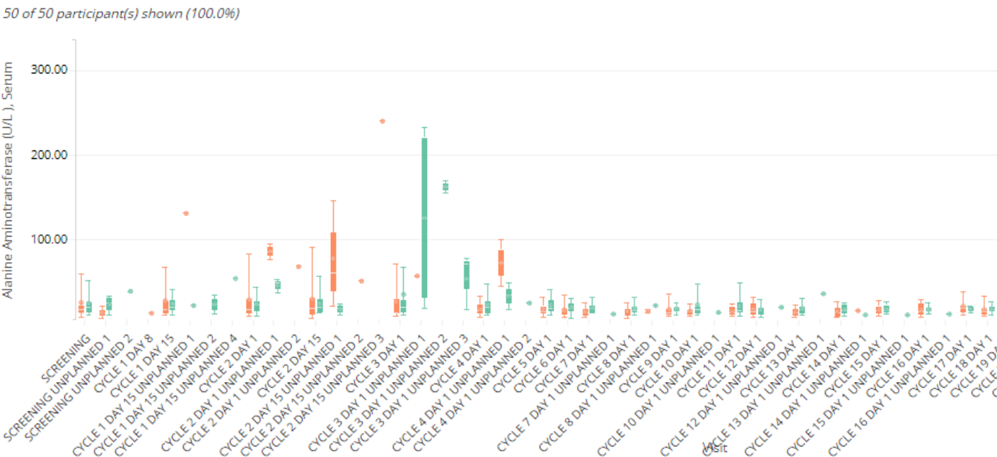
This is a continual process

Slide 35
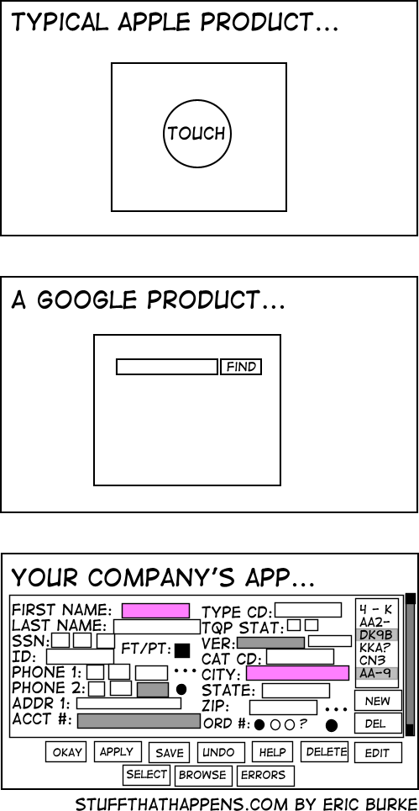
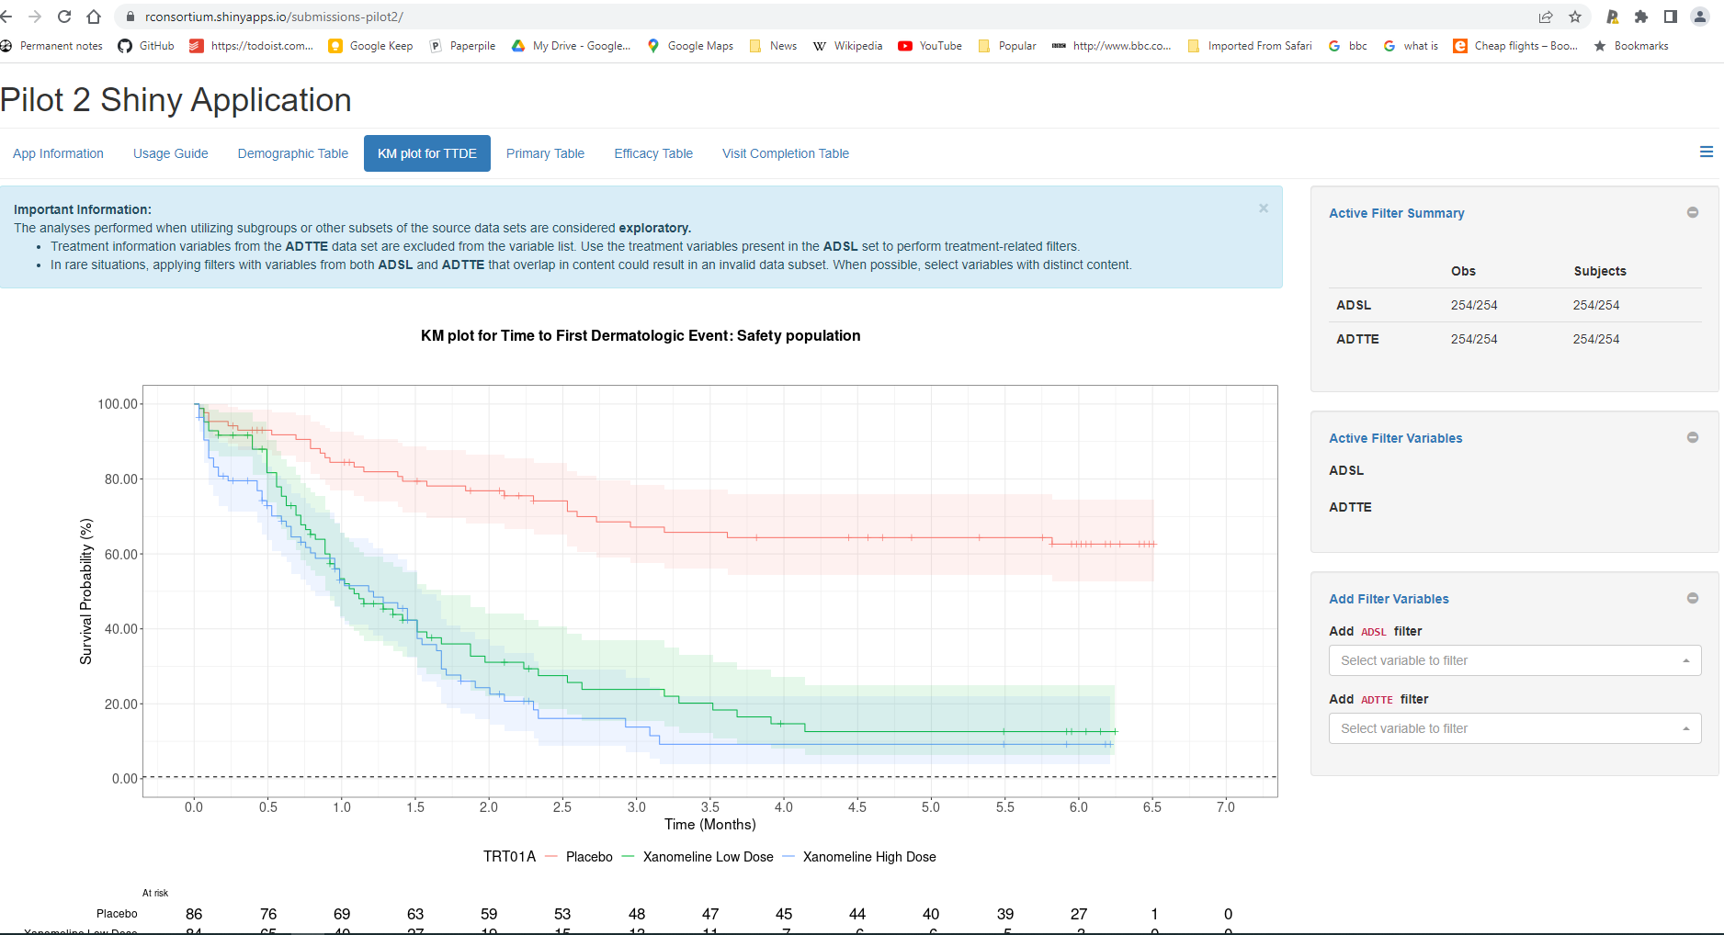
R for Pharma
H/T Simon Wandel

Slide 36
Effective visualization is a practice
Tufte: “Graphical competence demands three quite different skills: the substantive, statistical, and artistic.”
These skills cannot be learned by reading an article
Adopt visualization in every part of your workflow; make it a habit
Think graphically
Use pencil and paper before coding in software
Calculate and communicate
Test and repeat

Slide 37
Acknowledgements
Alison Margolskee
Marc Vandemeulebroecke
Baldur Magnusson
David Carr
Andrew Wright
Jürgen Löffler
Linda Kanitra
Baldur Magnusson
Matthew Brierley
David Ohlssen
Ivo Masseling
Armin Griesel
Janice Branson
Lorenz Uhlmann
Shaun Butcher
Julie Jones
Walter Hufford
Ruquan You
Ivan-Toma Vranesic
Ian Rees
Nicolas Guerro
Keo Chanthavinout
Frank Bretz
Bonnie Petrucka
Malika Cremer
And many more…

Slide 38
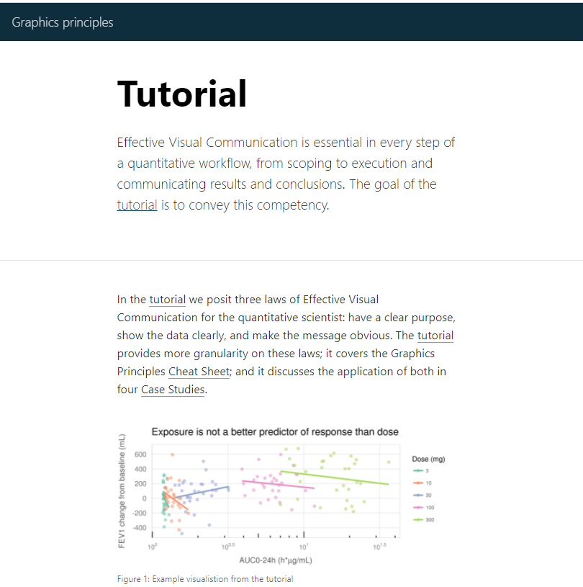
Resources, where to find out more?
Additional resources:
Effective Visual Communication Website https://graphicsprinciples.github.io/
PKPD Exploratory graphics (xGx) https://opensource.nibr.com/xgx
Tutorial on effective visual communication https://ascpt.onlinelibrary.wiley.com/doi/full/10.1002/psp4.12455
Video on the three principles https://youtu.be/pfxulpF9XOw
Presentation checklist https://opensource.nibr.com/xgx/Resources/Presentation_Checklist_v2.03.pdf
Wonderful Wednesdays https://www.psiweb.org/sigs-special-interest-groups/visualisation/welcome-to-wonderful-wednesdays

Slide 39
Contact:
mark.baillie@novartis.com

